Slide 1

Stacks & Queues
CISC 160
Data Structures
Brian Grey

Slide 2
What are we doing today?
Exceptions
Stacks
Behavior and interface
Example implementation
Queues
Behavior and interface
Example implementation

Slide 3
Exception Handling
What is it?
A process of anticipating, planning for, and handling run time exceptions in code
Helps programs fail gracefully
As previously mentioned, don’t over-plan
Don’t just catch everything and/or write an error message
(Although writing to the error log is a fine thing to do!)

Slide 4
Exceptions in Python
Are exceptions the same in all languages?
Eh…no and yes
You’re generally going to get the same flavors of exceptions as run-time exceptions are generally classifiable
Certain languages will have specific exception types unique to the language
Hierarchy of exceptions will be different
Let’s look at Python’s standard exceptions
(Oh, and what are warnings?)

Slide 5
Exceptions in Python
Is this it?
Depends on the libraries you import
PyGame, PyODBC, Numpy, etc. all have errors/exceptions that are specific to that library
Represent run-time exceptions that can only be raised by behavior in that library
Can we make our own exceptions?
YES!
Find an exception that represents a good base class
Extend it

Slide 6
Exception Handling Syntax
Syntax:
try: <statements> except [<type> [as <name>]]: <statements> [except [<type> [as <name>]]: <statements>]* [else: <statements>] [finally: <statements>]

Slide 7
But Why Exceptions?
Can we predict and prevent every problem in a program?
If I gave you any program and infinite amount of time/computing, could you determine if the program would complete successfully?
Assume we a have a program that determines this
A second program that takes the output of the first and does the opposite
If the first program determines that code will complete, the second program enters an infinite loop
Take the code for those two programs combined and feed it to itself
What will happen?

Slide 8
But Why Exceptions?
Can we predict and prevent every problem in a program?
If the combined program thinks that it will complete, then it loops infinitely
If the combined program thinks that it will not complete, then the program completes fine
A paradox forms no matter what
The Halting Problem and this proof was proposed by Alan Turing in 1936
Proved that somethings are unknowable
For us, this means that it is impossible to determine and prevent all issues with our code so we better be flexible

Slide 9
Using Exceptions Responsibly
If we are trying to prevent an issue, what can we do?
We should put an if statement around questionable code and proactively try to prevent issues
Depending on the situation, we can catch or raise an exception
raise <exception type>[(<error message>)]
Above code allows you to raise/throw any exception type that is available to the interpreter
All of this will be useful when we encounter system states that may not be preventable but may be predictable

Slide 10
Abstract Data Types
What is abstraction? (Again?)
Using only the essential elements to describe a system and leaving the more complex aspects to a lower level system
This is the opposite of a concrete data structure
(A low-level data structure that is literally implemented as a well-defined solution to a problem)
Definitionally, abstract data types (ADTs) define:
The interface of the data structure
Data stored within the data structure
Error conditions associate with any operations

Slide 11
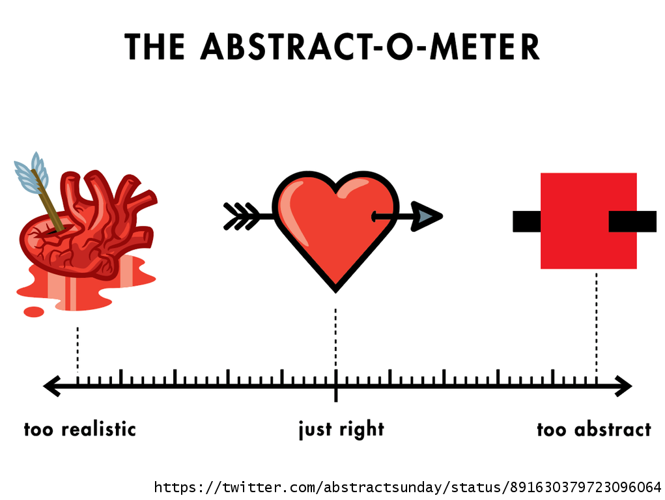
Abstract Data Types
What is abstraction? (Again?)
Using only the essential elements to describe a system and leaving the more complex aspects to a lower level system
The trick is being able to determine what are essential elements and what aspects can be handed off to another system
Too abstract means that you will likely miss key functionality
Too detailed means that you are likely doing unnecessary work

Slide 12
Abstract Data Types
What does this mean on a practical level?
ADTs explicitly defines interface and behavior
ADTs are implemented on top of another data structure
Think: dynamic arrays are implemented on top of static arrays
May be implemented with concrete data structure
For example, as we will discuss, stacks and queues can be implemented with an array or a linked list backing it
May be implemented on top of another ADT
Stacks and queues may be implemented with a dynamic array which is an ADT on implemented with a static array

Slide 13
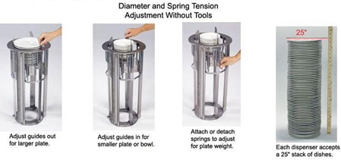

Stacks
Anyone know what this is?

Slide 14
Stacks
This spring-loaded plate stacker is the inspiration for the name of a stack
Stacks are last-in, first-out (LIFO) abstract data structures that can store objects of an arbitrary type
All access to the content of the stack is done from the same end
You can NEVER see inside of the stack
One of the oldest ADTs and is implemented at a low level for computer languages and operating systems
Proposed by Alan Turing in 1946
Has been used in computer architecture since the mid-1950’s

Slide 15
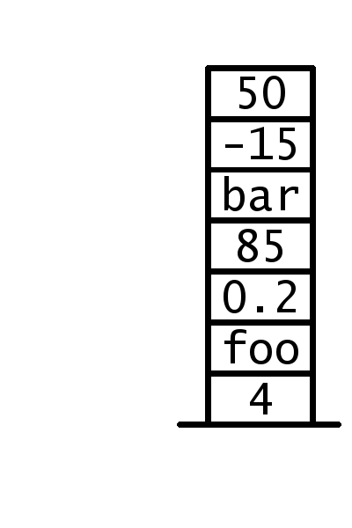
Stack Terminology
The terminology surrounding a stack has not changed since it was first implemented
This means that if you spoke to a computer scientist from 1960, you could discuss stacks using some standard terminology
Because stacks are named for the “plate stacker” analogy, they take a vertical orientation
The first/oldest element in a stack is said to be “on the bottom of the stack”

Slide 16
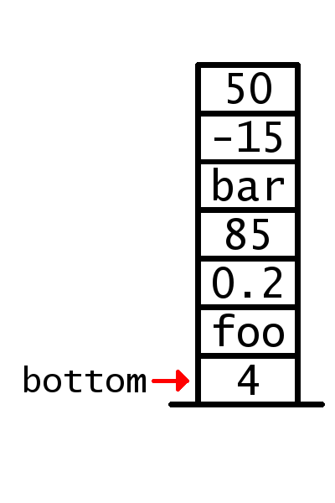
Stack Terminology
The terminology surrounding a stack has not changed since it was first implemented
This means that if you spoke to a computer scientist from 1960, you could discuss stacks using some standard terminology
Because stacks are named for the “plate stacker” analogy, they take a vertical orientation
The first/oldest element in a stack is said to be “on the bottom of the stack”
The most recently added element is “on top”

Slide 17
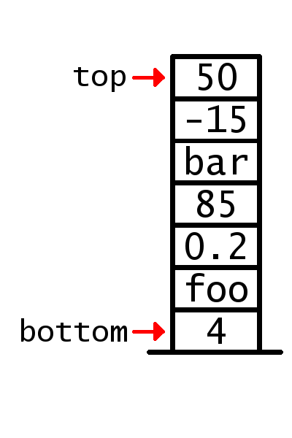
Stack Terminology
The terminology surrounding a stack has not changed since it was first implemented
This means that if you spoke to a computer scientist from 1960, you could discuss stacks using some standard terminology
Because stacks are named for the “plate stacker” analogy, they take a vertical orientation
The first/oldest element in a stack is said to be “on the bottom of the stack”
The most recently added element is “on top”
FIRST AND LAST HAS NO MEANING WITH STACKS

Slide 18
Stack Interface
Similarly, the interface is largely unchanged
Primary methods of a stack:
S.push(object): puts a new object on top of the stack
S.pop(): attempts to take an object off the top of the stack
Additional methods common to stacks:
S.peek() or S.top(): attempts to access the object on the top of the stack without removing it from the stack
len(S): returns the number of elements in the stack
S.is_empty(): returns true if there are no elements in the stack
Errors occur if the stack is empty and pop, peek, or top is called

Slide 19
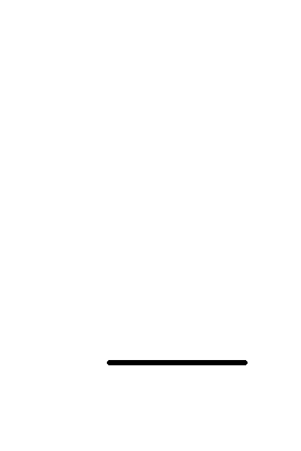
Stack example
Let’s examine the contents of a stack during the following:
s = Stack() s.push(10) s.push(20) print( len(s) ) s.push(30) print( s.pop() ) print( s.pop() ) print( s.top() ) print( s.is_empty() ) print( s.pop() ) print( s.is_empty() ) print( s.top() ) s.push(4)

Slide 20
Stack Interface & Implementations
Let’s truly separate interface from implementation
(We can also drive home the purpose of an abstract object or method)
Let’s define an abstract Stack_Interface object before working on actual implementations
As a stack is an ADT, we need a data type as a backing data structure to store our data
Three options:
Array / Dynamic Array / Linked List

Slide 21
Stack_interface.py
From abc import abstractmethod,ABC
Class Stack_Interface(ABC):
@abstractmethod
def __init__(self):
pass
@abstractmethod
def push(self,element):
pass
@abstractmethod
def pop(self):
pass
@abstractmethod
def peek(self):
pass
def is_empty(self):
return len(self)==0
@abstractmethod
def __len__(self):
pass

Slide 22

Stack Implementation #1: Array
Stacks only add and remove from one end
If we are implementing using an array, what is the operation that we want to avoid using?
Adding an element at an arbitrary index is $O\left(n\right)$
Because all elements after the index must be copied down
What operations/list states do we want to take advantage of?
Accessing an arbitrary index is FAST
Overwriting data at an arbitrary index is FAST
So, if the slot is unused, then we can get to and overwrite it quickly

Slide 23
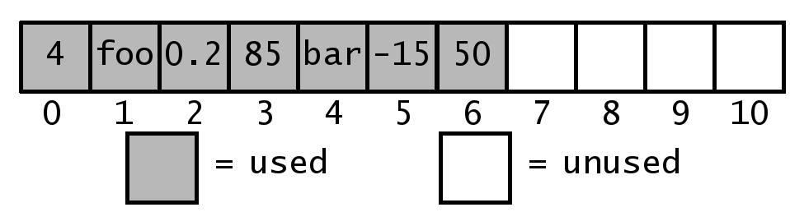

Stack Implementation #1: Array
What does this mean for our design?
First, we must create an array that is larger than we need
If we “left justify” the data, we know where the bottom is
We can then write to any unused slot in the array in $O\left(1\right)$

Slide 24
Stack Implementation #1: Array
What does this mean for our design?
Therefore, the top of the stack should be the end of the currently used portion of our array
Pushing onto a stack = writing to the first slot past the used portion of the array (at an index of len(S) )
Popping off of the stack = saving the element at len(S)-1, overwriting that slot, decrementing your length variable, and returning the saved element
Peeking at the top of the stack = accessing the element at len(S)-1

Slide 25

Stack Implementation #1: Array
What does this mean for our design?
Therefore, the top of the stack should be the end of the currently used portion of our array
Under this design, all operations of the stack are $O\left(1\right)$!
Just like the linked list implementation!
However, the memory representation is more tightly aligned and uses less memory
Of course, there is a risk that you didn’t make the array big enough in the beginning
I hate having to resize my arrays…

Slide 26

Stack Implementation #2: Dynamic Array
The same as an array, only we don’t have to resize
All implementation details are identical
But we do not have to resize our array when we run out of space
Python uses a geometric resizing approach, meaning that resizes are done as a proportion of the current size
Resize operations become less common as the array grows
Under this paradigm, adding to a dynamic array is amortized to $O\left(1\right)$
Under this design, all operations of the stack are $O\left(1\right)$!
But memory is still required to be contiguous

Slide 27

Stack Implementation #3: Linked List
Stacks only add and remove from one end
If we are implementing using a linked list, what is the operation that we want to avoid using?
Access of an arbitrary element is $O\left(n\right)$
Getting to an element not near the front of the list is slow
What operations/list states do we want to take advantage of?
Adding to and removing from a linked list is FAST
Accessing the head node is FAST

Slide 28

Stack Implementation #3: Linked List
What does this mean for our design?
Therefore, the top of the stack should be the head node
Pushing onto a stack = adding in front of the current head node
Popping off of the stack = removing the current head node and returning the element inside
Peeking at the top of the stack = accessing the element at the current head node
Under this design, all operations of the stack are $O\left(1\right)$!
But linked lists do eat up more memory than arrays…

Slide 29
Class ListStack(Stack_Interface):
Def push (self, element):
self._data.append(element)
Def pop(self):
if self.is_empty():
raise StackException(“Cannot check the top element of an empty stack”)#Stack Exception is an abstract class
return_value = self._data[len(self) – 1]
del(self._data[len(self) – 1])
return return_value
Def peek(self):
if self.is_empty():
raise StackException(“Cannot check the top element of an empty stack”)#Stack Exception is an abstract class
return_value = self._data[len(self) – 1]
return return_value

Slide 30
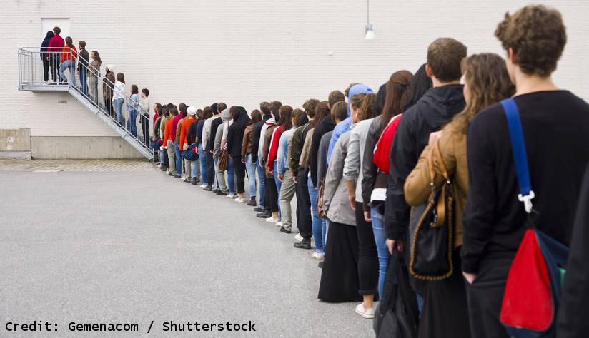
Queues
What does the word “queue” conjure images of?

Slide 31
Queues
This bureaucratic nightmare is the inspiration for the name of a queue
Queues are first-in, first-out (FIFO) abstract data structures that can store objects of an arbitrary type
Access to the content of the queue is done on the opposite end of where the data is entered
You can NEVER see inside of the queue
Very common data structure for ordering and prioritizing data

Slide 32
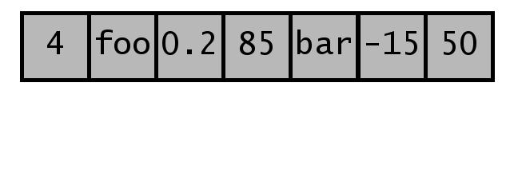
Queue Terminology
While not as old as stacks, the terminology surrounding queues has long been standardized
Like most linear data structures, they take a horizontal orientation
The first/oldest element in a queue is said to be “at the front of the queue”

Slide 33
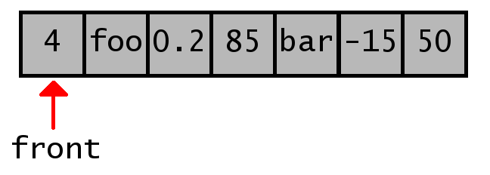
Queue Terminology
While not as old as stacks, the terminology surrounding queues has long been standardized
Like most linear data structures, they take a horizontal orientation
The first/oldest element in a queue is said to be “at the front of the queue”
The most recently added element is “at the back”

Slide 34
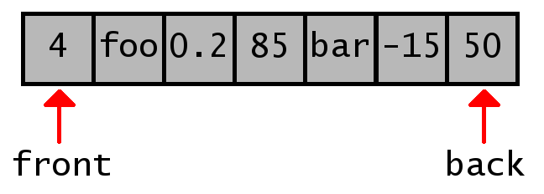
Queue Terminology
While not as old as stacks, the terminology surrounding queues has long been standardized
Like most linear data structures, they take a horizontal orientation
The first/oldest element in a queue is said to be “at the front of the queue”
The most recently added element is “at the back”

Slide 35
Queue Interface
Like its terminology, the queue’s interface is standardized
Primary methods of a queue:
Q.enqueue(object): puts a new object at the back of the queue
Q.dequeue(): attempts to take an object off the front of the queue
Additional methods common to queues:
Q.front() or Q.first(): attempts to access the object on the front of the queue without removing it from the queue
len(Q): returns the number of elements in the queue
Q.is_empty(): returns true if there are no elements in the queue
Errors occur if the queue is empty and dequeue, front, or first is called

Slide 36
Queue example
Let’s examine the contents of a queue during the following:
q = Queue() q.enqueue(10) q.enqueue(20) print( len(q) )#2 q.enqueue(30) print( q.dequeue() )#30 print( q.dequeue() )#20 print( q.front() )#10 print( q.is_empty() )#FALSE print( q.dequeue() )#10 print( q.is_empty() )#TRUE print( q.front() )#NONE q.enqueue(40)

Slide 37
Queue Interface & Implementations
Like a stack, let’s separate the interface from the implementation of a queue
Let’s define an abstract Queue_Interface object before working on actual implementations
As a queue is an ADT, we need a data type as a backing data structure to store our data
Three options:
Array / Dynamic Array / Linked List

Slide 38

Queue Implementation #1: Array
Queues add on one end and remove from the other
If we are implementing using an array, what is the operation that we want to avoid using?
Adding an element at an arbitrary index is $O\left(n\right)$
Because all elements after the index must be copied down
What operations/list states do we want to take advantage of?
Accessing an arbitrary index is FAST
Overwriting data at an arbitrary index is FAST
So, if the slot is unused, then we can get to and overwrite it quickly

Slide 39

Queue Implementation #1: Array
What does this mean for our design?
First, we must create an array that is larger than we need
We can also “left justify” the data, just like we did with a stack
But then every time we dequeue, everything has to be shifted
This action is $O\left(n\right)$

Slide 40
Queue Implementation #1: Array
What does this mean for our design?
If we don’t “left justify” the data, now need to track the front

Slide 41
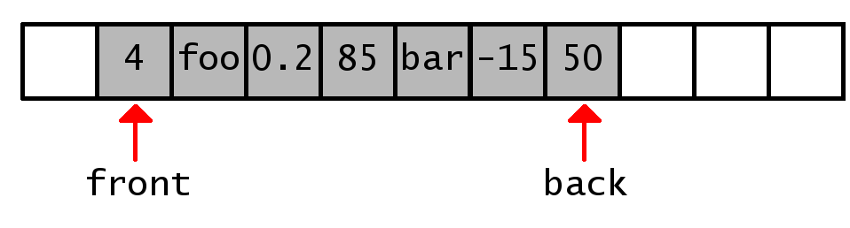

Queue Implementation #1: Array
What does this mean for our design?
If we don’t “left justify” the data, now need to track the front
Also need know where the back is (front + queue length – 1)
All actions are writing to empty slots or incrementing indicies
These actions are $O\left(1\right)$

Slide 42
Queue Implementation #1: Array
What’s the potential problem?
Let’s walk through some actions:

Slide 43
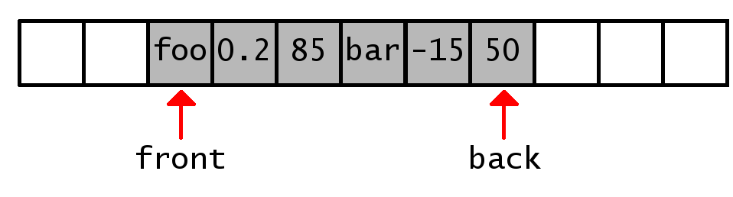
Queue Implementation #1: Array
What’s the potential problem?
Let’s walk through some actions:

Slide 44
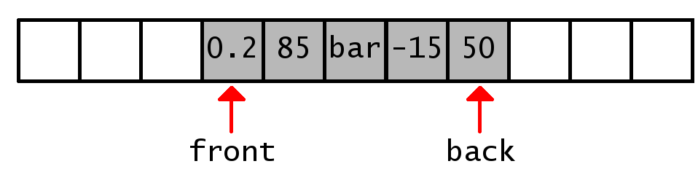
Queue Implementation #1: Array
What’s the potential problem?
Let’s walk through some actions:

Slide 45
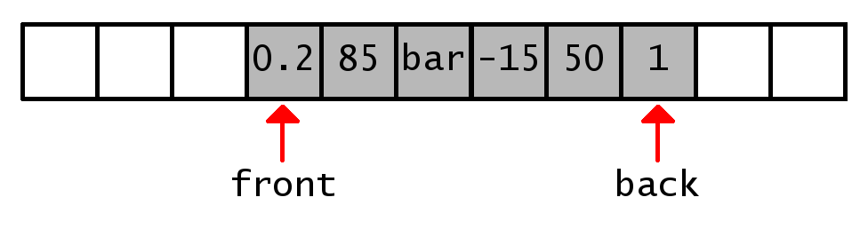
Queue Implementation #1: Array
What’s the potential problem?
Let’s walk through some actions:

Slide 46
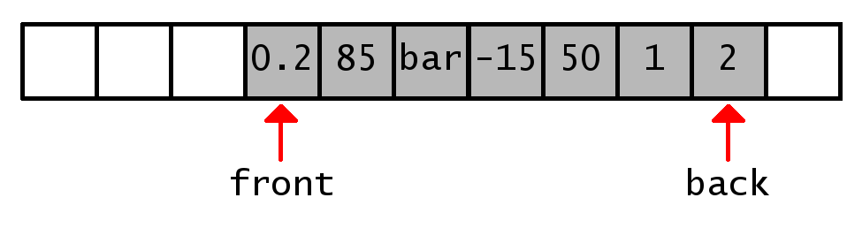
Queue Implementation #1: Array
What’s the potential problem?
Let’s walk through some actions:

Slide 47
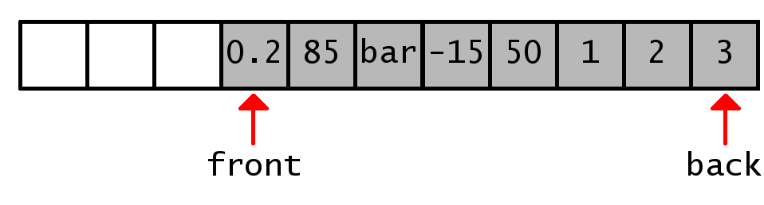

Queue Implementation #1: Array
What’s the potential problem?
Let’s walk through some actions:
Uh………now what?
We could shift everything down but then we’re back where we started with actions running at $O\left(n\right)$ OR…

Slide 48
Queue Implementation #1: Array
We can treat our static array like a circular array
Once we move past the end of the array, we start adding to the empty slots at the beginning of the array
How do we know if we’re in a “standard” or circular configuration?
Our “back index” calculation is (front + queue length – 1)
If that’s greater than (array size – 1), then we’re circular
Otherwise, we’re in a standard configuration

Slide 49
Queue Implementation #1: Array
We can treat our static array like a circular array
Because of this, the actual equation for the index of the element at the back of the queue in a circular array is:
(front + queue length – 1) % (array size)
The index for the next empty slot for the queue to enqueue into in a circular array is:
(front + queue length) % (array size)

Slide 50
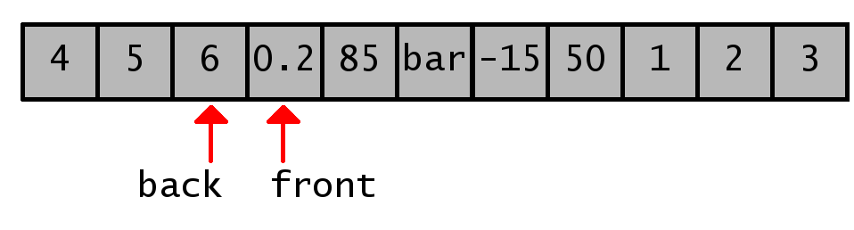
Queue Implementation #1: Array
What does this mean for our design?
Resizing becomes a challenge
What happens when we expand this array?

Slide 51
Queue Implementation #1: Array
What does this mean for our design?
Resizing becomes a challenge
Doing a strict expansion would introduce gaps in the data
BAD!
Best practice is to reset the front of queue to be at the beginning of the array during the copy portion of the array expansion process

Slide 52
Queue Implementation #2: Dynamic Array
Don’t
As we just saw, It helps to have control over the resize process for resetting the front of the queue to the beginning of the array
What will happen if you use maintain a “circular” paradigm and don’t control when and how the resize process happens?
Will the array ever be circular?
What will the dynamic array look like after 1 million elements have be enqueued and 999,999 elements have been dequeued?
One lonely element with 999,999 empty slots preceding it
Notes:
q.enqueue(x)
While True:
q.enqueue(x)
q.dequeue()

Slide 53

Queue Implementation #3: Linked List
Queues require only add on one end and removing from the other
If we are implementing using a linked list, what is the operation that we want to avoid using?
Access of an arbitrary element is $O\left(n\right)$
Getting to an element not near the front of the list is slow
Uh oh…how do we get around this?
If we implement a tail link, we can remember where the last element of our linked list is as well
This eliminates the need to iteratively find the last node

Slide 54

Queue Implementation #3: Linked List
What does this mean for our design?
With this, the front of the list should be the head
Enqueuing into the queue = adding behind the tail node then updating the tail node
Dequeuing from the queue = removing the current head node and returning the element inside
Looking at the front of the queue = accessing the element at the current head node
Under this design, all operations of the stack are $O\left(1\right)$!
But linked lists do eat up more memory than arrays…

Slide 55
Final Thoughts
All of the options we discussed (barring the dynamic array implementation of a queue) are equally valid
It all depends on the needs and the use case
The point of these options are to illustrate not that there’s a right way, rather there’s several potential right ways
This is why it’s called a design DECISION
(There would be no decision involved if there was a universally accepted always correct implementation)
Knowing your options provides you with flexibility

Slide 56
Questions?

